Slide 1
UNIT 9: Live Session
Introduction to Linear Regression

Slide 2
Last time we considered ….
Example :
Studying Hours and Grades!

Slide 3
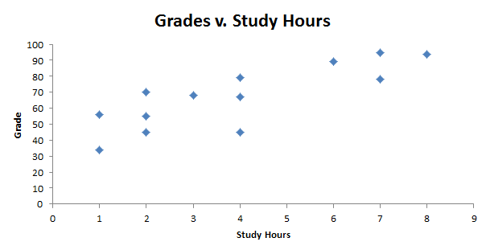
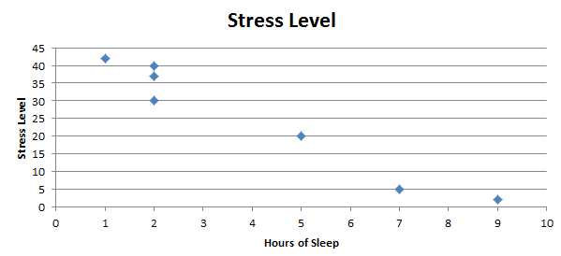
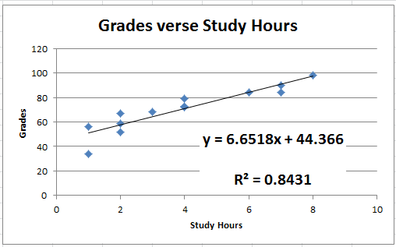
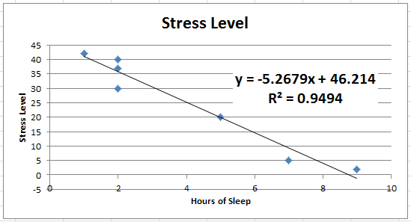
Grades v. Study Hours
A
B

Slide 4
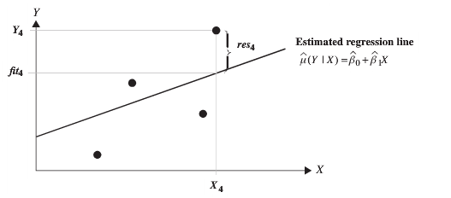
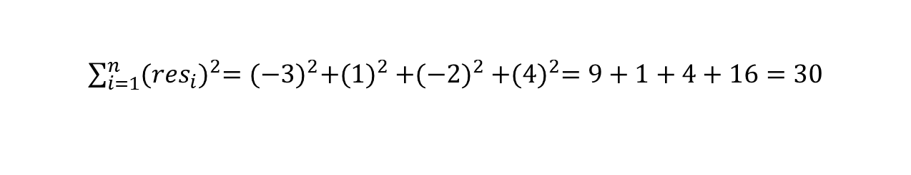
How to find the “Best” Line
Residuals: res = observed - predicted
Want to minimize a function of the residuals to find the “best” line.
0
What is the sum of the residuals here?
But…there are many lines that have residuals that sum to 0.
res₄ = 4
We want the sum of vertical distances from the points to the line to be minimized…Distance is absolute value! (Takes every residual and makes it positive.)
res₂ = 1
res₃ = -2
res₁ = -3
But the absolute value function is not differentiable, making the minimization process very difficult. (Can’t use simple-ish math.) AND there can be more than one line that minimizes the sum of absolute values.
This is why we will square each residual and then sum them together. (Squaring makes everything positive!)
Sum of Squared Residuals = SSR =

Slide 5
Grades v. Study Hours
res₁₀ = 7
res₆ = 5
res₁₁ = 30
res₁ = -10
res₇ = 20
res₅ = 60
The squared and summed green residuals will be greater than the squared and summed red residuals.
SSR_{red} < SSR_{green}

Slide 6
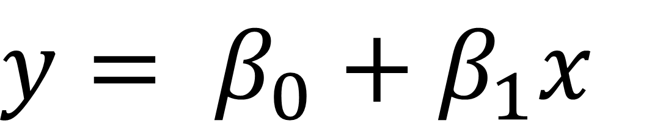
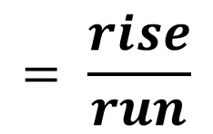
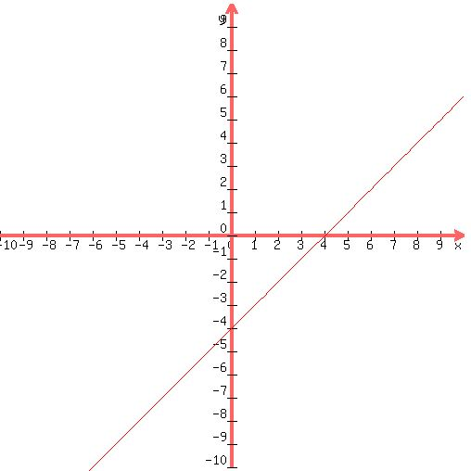


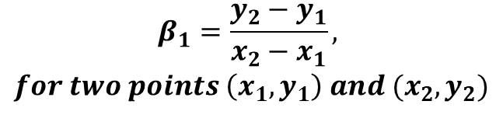
Equation of a Line!!!
y = mx + b
$$β_{1}=\frac{y_{2}−y_{1}}{x_{2}−x_{1}},$$
$$for two points \left(x_{1}, y_{1}\right) and (x_{2}, y_{2})$$
y-intercept

Slide 7
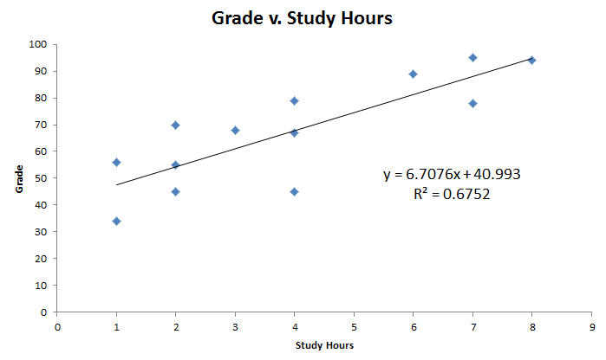
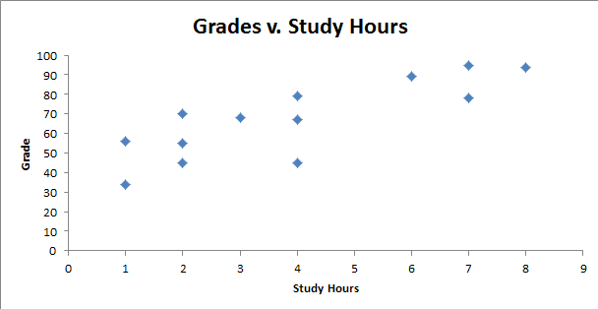
Grades v. Study Hours
We can use the regression line to predict a grade given the number of hours studied.
The estimated grade for a student who studied for four hours would be:
Predicted Grade = 6.7076(4 hours) + 40.993 = 67.8234 points
Try one! Given this data, predict the grade a student who studied 7 hours would receive.
Predicted Grade = 6.7076(7 hours) + 40.993 = 87.94 points

Slide 8
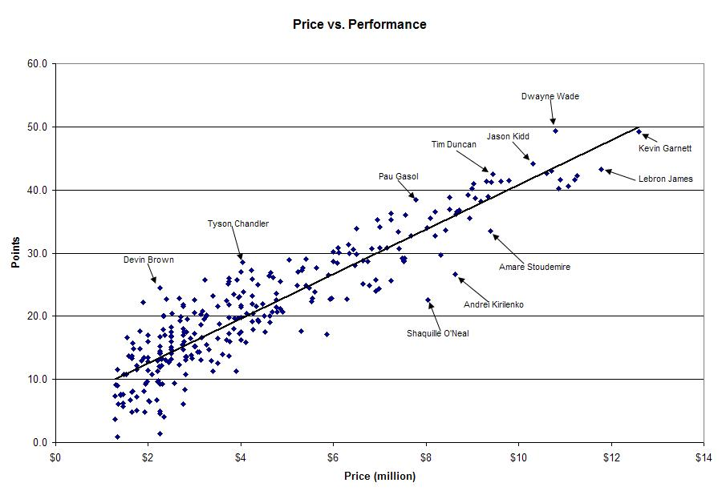

r = 0.907
r² = 0. 823
$\hat{Points}$ = 6 + 3(Price)
Give it a shot! (No pun intended!) ….
What is the best predicted max points in a single game for a player who is paid $9.5 million?
Predicted Max Points = 6 + 3 * 9.5 = 34.5 points!

Slide 9
Extrapolation!
The predictions are only valid for values of x inside of the domain of x that were used to build the model.
That is, for the Grade vs. Study Hours data set, the regression equation is only valid for study hours as small as 1 and as large as 8 hours.
Any prediction outside of the domain of x that was used to build the model is known as extrapolation.

Slide 10
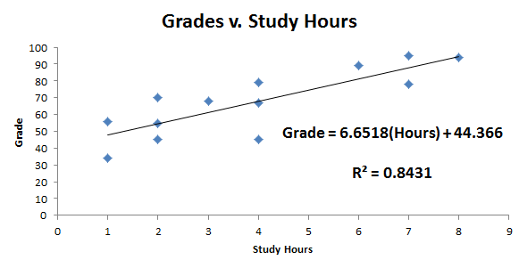
Extrapolation: Example
Given this data, predict the grade a student who studied 18 hours would receive...
Predicted Grade = 6.6518(18 hours) + 44.366 = 164.1points
Clearly this is impossible … but we have extrapolated.

Slide 11
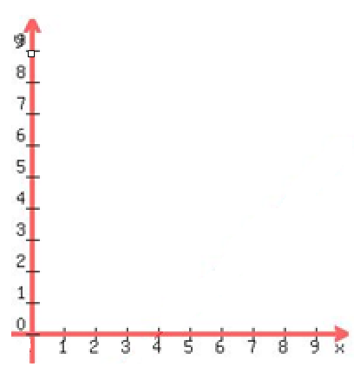


Interpretation: Slope and Y – Intercept
(1,3.5)
Slope = (3.5-1.5)/(1-0)=2
(0,1.5)
Slope Interpretation: A 1 unit increase in x results in a 2 unit increase in predicted y.
Y-intercept Interpretation: The predicted response that corresponds to x = 0 is 1.5.

Slide 12
Grades v. Study Hours
Interpret the slope:
Each extra hour spent studying results in a 6.6518 point increase in the predicted grade.
Interpret the y – intercept:
The predicted grade for a student who studies no hours is 44.37 points.
(Of course, this is an extrapolation in this study and would not be a great model to use for a student who studied zero hours.)

Slide 13
r = .907
r² = 0. 823
$\hat{Points}$ = 6 + 3(Price)
Slope Interpretation:
Each $1 million increase in the price results in a 3 point increase in predicted max point production for a game.
Y-Intercept interpretation:
A player who is not paid is still predicted to have 6 max points.
Why doesn’t this make sense?
EXTRAPOLATION

Slide 14
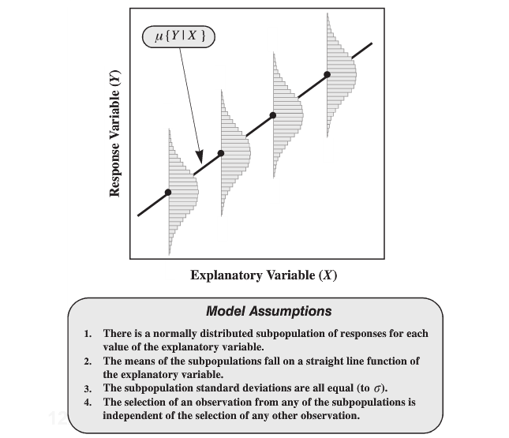
Assumptions

Slide 15
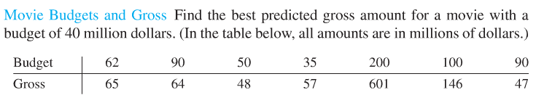
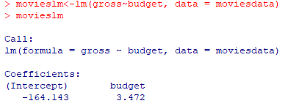
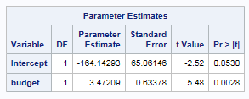

Movies: Regression equation and a predicted value of y for a given x
proc glm data = movie;
model gross = budget;
run;
OR
proc reg data= movie;
model gross = budget;
run;
Equation of Regression Line
Predicted Gross = 3.472 * Budget – 164.14
Predicted Gross for a Budget of $40 million:
$\hat{y40}$=3.472(40) – 164.14 = -$25 million!

Slide 16

The Residual formalized!!!

Slide 17

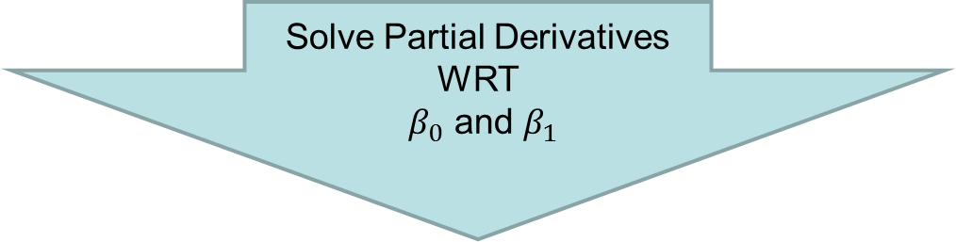
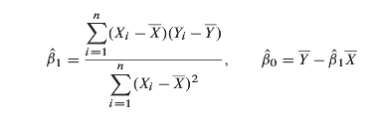

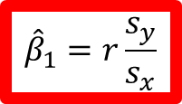
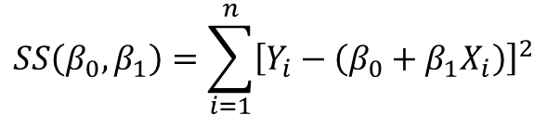
How to Estimate Regression Coefficients
$$SS\left(β_{0},β_{1}\right)=\sum_{i=1}^{n}{{\left[Y_{i}−\left(β_{0}+β_{1}X_{i}\right)\right]}^{2}}$$
$$=0$$
$${\hat{β}}_{1}=r\frac{s_{y}}{s_{x}}$$

Slide 18
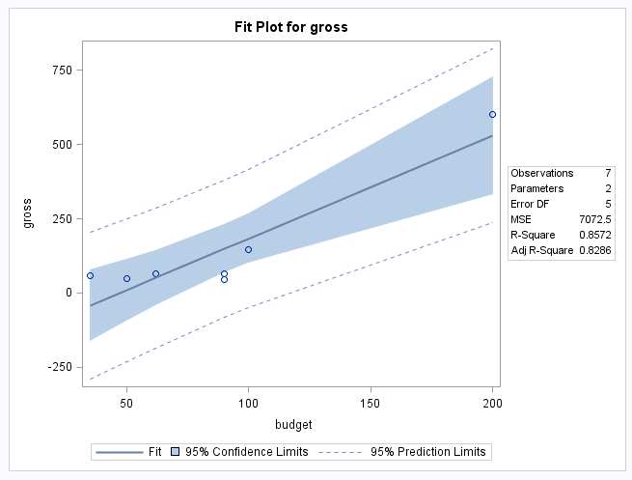
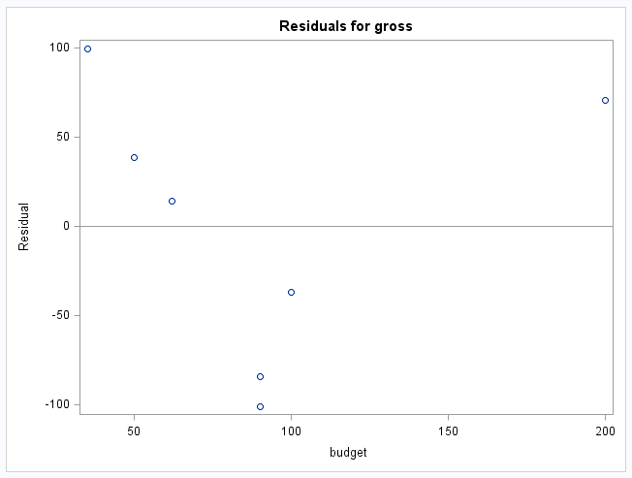
Movies: graphs
Prediction and confidence intervals: prediction intervals are much wider than confidence intervals. (We will discuss these more in unit 10.)
Residual plots can be used to look for normal residuals and equal standard deviations across the range of x’s.
proc glm data = movie plots =all;
model gross = budget;
run;
OR
proc reg data= movie;
model gross = budget;
run;
We will learn how to do the left graph in r during week 10.

Slide 19
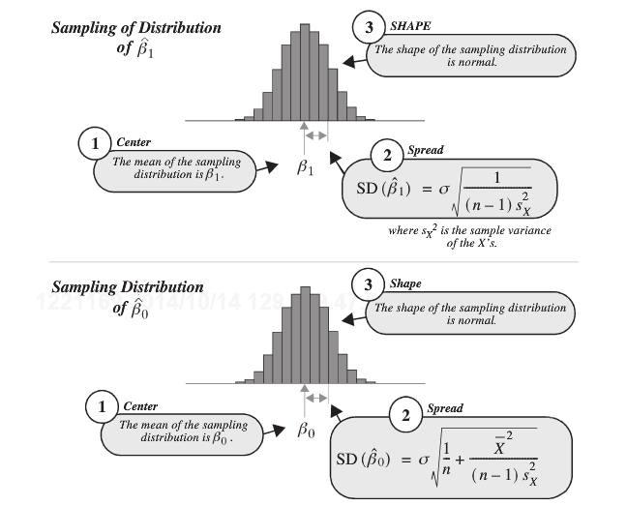
Sampling Distributions / Hypothesis Test

Slide 20
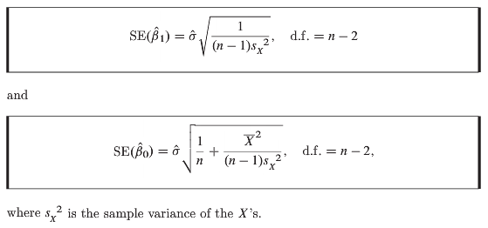

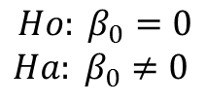
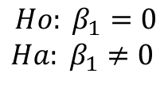
Sampling Distributions / Hypothesis Test
Two T-Tests!!!

Slide 21
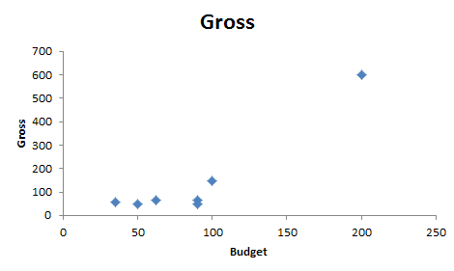
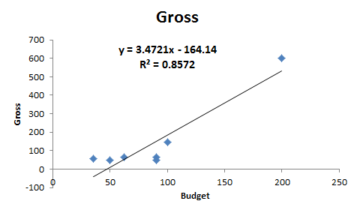


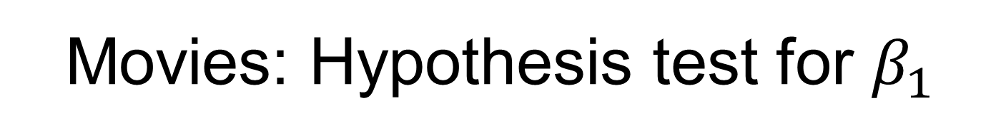
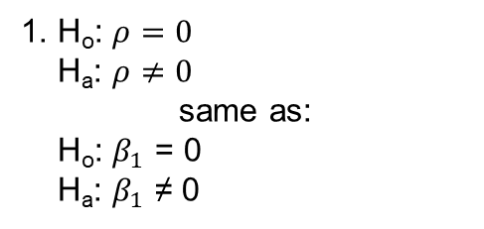
Movies: Hypothesis test for $β_{1}$
1. H_{o}: $ρ=0$
H_{a}: $ρ≠0$
same as:
H_{o}: $β_{1}$ = 0
H_{a}: $β_{1}$ ≠ 0
5. Reject H_{o}.
6. There is sufficient evidence at the alpha = .05 level of significance (p-value = .0028) to suggest that the data are linearly correlated (or that the slope is nonzero). We will proceed to calculate the regression line.
2. CV: $±t_{.975, 7−2=5}$ = $±$2.54
3. t = 5.48
4. p-value = .0028
t-stat = (parameter estimate – 0)/StErr
Equation of Regression Line:
Predicted Gross = – 164.14 + 3.472 * Budget
SAS

Slide 22
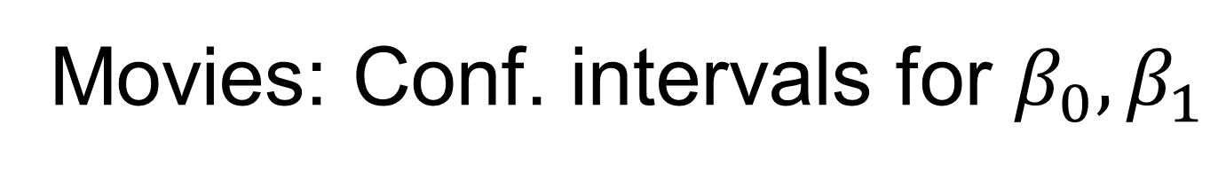
Movies: Conf. intervals for $β_{0},β_{1}$
Estimate ± t_{α/2,df}*SE
df = n-2
Estimate ± t_{α/2,df}*SE
df = n-2
Budget_slope ± t_{.025,5}*SE
Y-Intercept ± t_{.025,5}*SE
3.472 ± 2.571*.6338
-164.143 ± 2.571*65.06
(1.84, 5.10)
(-331.39,3.103)
We are 95% confident that when the budget is increased by $1 million dollars, the mean gross increases between $1.84M and $5.10M.
We are 95% confident that for a budget of $0, the mean gross is between $0M and $3.103M.

Slide 23
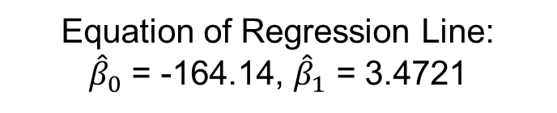
Movies: Parameter interpretation
Equation of Regression Line:
${\hat{β}}_{0}$ = -164.14, ${\hat{β}}_{1}$ = 3.4721
Pred. Gross = – 164.14 + 3.472 * Budget
Interpret the Slope:
It is estimated that for every increase in $1 million to the budget, the estimated gross will be $3.4721 million more. A 95% confidence interval is ($1.84 M, $5.10 M).
Interpret the y-intercept:
For a movie with no budget ($0), it is predicted that it will gross $0 (-$164 million from regression equation). A 95% confidence interval is ($0, $3.3 M). This has little practical meaning, which is to be expected since it is extrapolation.

Slide 24
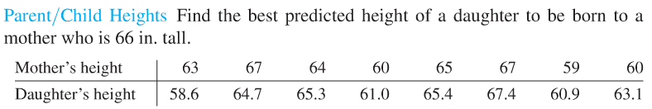
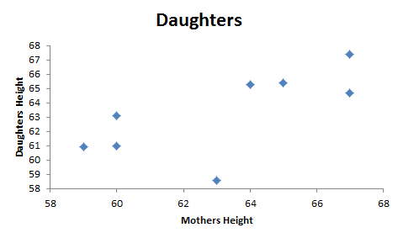
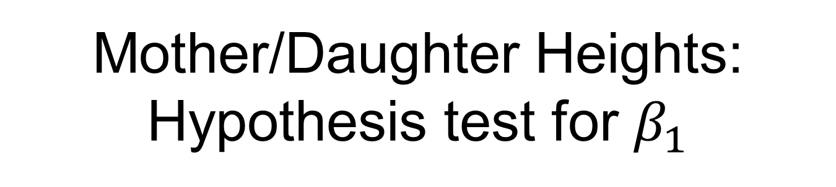
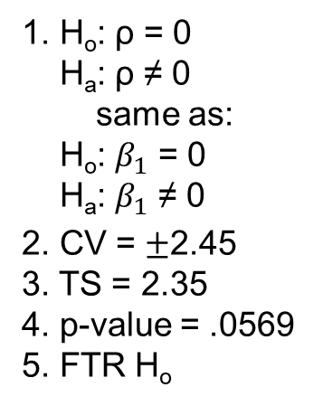
Mother/Daughter Heights: Hypothesis test for $β_{1}$
6. There is not sufficient evidence at the alpha = .05 level of significance (p-value = .0569) to suggest that the data are linearly correlated or the slope is nonzero.
1. H_{o}: ρ = 0
H_{a}: ρ ≠ 0
same as:
H_{o}: $β_{1}$ = 0
H_{a}: $β_{1}$ ≠ 0
2. CV = $±$2.45
3. TS = 2.35
4. p-value = .0569
5. FTR H_{o}
The best predicted height of a daughter given the mother’s height is the average of the daughters’ heights in the sample.
How do we estimate the height of the daughter when the height of the mother is not a significant predictor?
Best Predicted Value is the average height:
63.3 inches

Slide 25
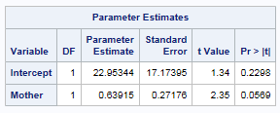
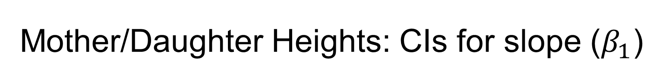
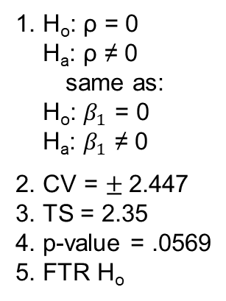
Mother/Daughter Heights: CIs for slope ($β_{1}$)
6. There is not sufficient evidence at the alpha = .05 level of significance (p-value = .0569) to suggest that the data are linearly correlated or that the slope is nonzero. The best predicted height of a daughter given the mother’s height is the average of the daughters’ heights in the sample.
1. H_{o}: ρ = 0
H_{a}: ρ ≠ 0
same as:
H_{o}: $β_{1}$ = 0
H_{a}: $β_{1}$ ≠ 0
2. CV = $±$2.447
3. TS = 2.35
4. p-value = .0569
5. FTR H_{o}
Estimate ± t_{α/2,df}*SE
df = n-2
Mother ± t_{.025,6}*SE
.63915 ± 2.447*.27176
(-.02585, 1.304)
Notice the interval contains zero, which implies that the slope could be 0, or that no linear correlation (ρ = 0) is plausible given the data. The interval agrees with our hypothesis test!

Slide 26
Break Out!!!

Slide 27
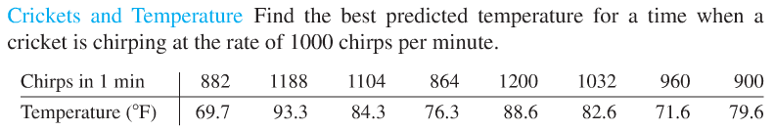
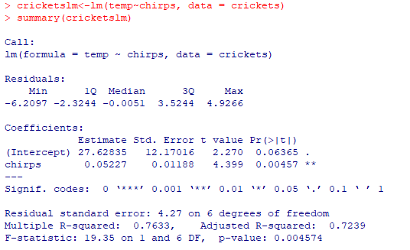
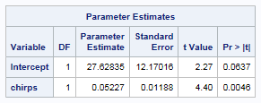


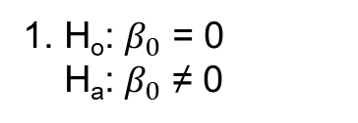
Crickets: $β_{0}$ ≠ 0?
It might seem counterintuitive to predict temperature based on the number of chirps (versus the other way around), but that is the question of interest here!
5. Fail to reject H_{o}.
6. There is not sufficient evidence at the alpha = .05 level of significance (p-value = .0637) to suggest that the y- intercept is nonzero. We will proceed to test the slope.
1. H_{o}: $β_{0}$ = 0
H_{a}: $β_{0}$ ≠ 0
2. CV = $±$2.45
3. TS = 2.27
4. p-value = .0637
proc glm data = crickets;
model temp=chirps;
run;
OR
proc reg data = crickets;
model temp=chirps;
run;
SAS

Slide 28
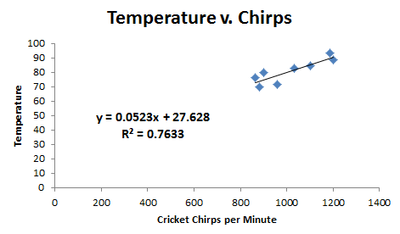
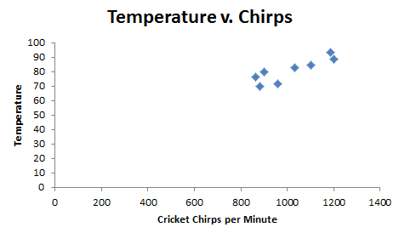

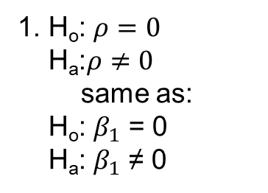


Crickets: $β_{1}$ ≠ 0?
It might seem counterintuitive to predict temperature based on the number of chirps (versus the other way around), but that is the question of interest here!
1. H_{o}: $ρ=0$
H_{a}:$ρ≠0$
same as:
H_{o}: $β_{1}$ = 0
H_{a}: $β_{1}$ ≠ 0
5. Reject H_{o}.
6. There is sufficient evidence at the alpha = .05 level of significance (p-value = .0046) to suggest that the data are linearly correlated or that the slope is nonzero. We will proceed to calculate the regression line.
2. CV = $±$2.45
3. TS = 4.40
4. p-value = .0046
Equation of Regression Line
Temp =.0523 * Chirps + 27.63
The intercept is not significant, but we include it in the model because a higher degree term IS significant.
SAS
EXCEL

Slide 29
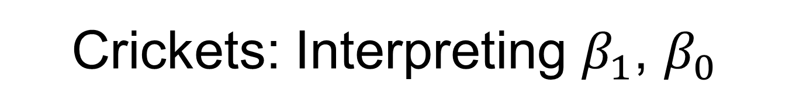
Crickets: Interpreting $β_{1}$, $β_{0}$
Equation of Regression Line
Pred. Temp =.0523 * Chirps + 27.63
Interpret the slope:
For every increase in 1 chirp per minute the estimated temperature increases 0.0523 degrees F.
Interpret the y-intercept:
If there are no crickets chirping, the estimated temperature is 27.63 degrees F. While this is extrapolation, it does have a practical interpretation.

Slide 30

Crickets: Conf. Intervals for $β_{0},β_{1}$
Estimate ± t_{α/2,df}*SE
df = n-2
Estimate ± t_{α/2,df}*SE
df = n-2
Chirps_slope ± t_{.025,6}*SE
Intercept ± t_{.025,6}*SE
.05227 ± 2.447*.0119
27.63 ± 2.447*12.17
(.0232, .0813)
(-2.151, 57.41)
We are 95% confident that for every additional chirp, the mean temperature is increased between .0232 and .0813 degrees F.
We are 95% confident that the intercept is between -2.151 and 57.41.

Slide 31

Crickets: predicting y for a given x
Equation of Regression Line
Pred. Temp =.0523 * Chirps + 27.63
Predicted temperature when a cricket is chirping 1000 times per minute:
$\hat{y1000}$=.0523(1000) + 27.63 = 79.9 degrees F

Slide 32
Appendix

Slide 33
SAS Code for Movie data: two options to find confidence intervals for parameters (betas)
data movie;
input budget gross;
datalines;
62 65
90 64
50 48
35 57
200 601
100 146
90 47
;
proc print data = movie;
run;
proc glm data = movie;
model gross = budget / clparm;
run;
OR
proc reg data= movie;
model gross = budget / clb;
run;

Slide 34

R Code For Movie Data

Slide 35



Marathons!!!
Best Predicted Value is the average time: 147.077 sec.

